Slide 1

ALCOHOL DETECTION AND SMS ALERT SYSTEM
IoT DEPARTMENT

Slide 2
AGENDA
Introduction​
Components Used
Working and Factors
​Summary​

Slide 3
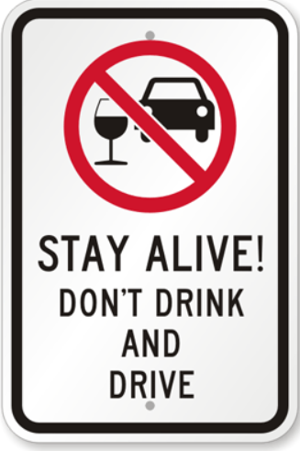
PRIMARY GOALS
REDUCE ACCIDENTS RELATED TO DRINK AND DRIVE STATE.

Slide 4
Introduction
Whenever a person consumes alcohol and drives the vehicle or car , it is prone to get into an accident .
Hence to avoid these situations we have built an intelligent system which doesn’t turn on the engine of car if the person consumes alcohol and drives .
Also , it automatically sends an “SMS” alert to registered number or family member that so and so person has consumed alcohol and trying to drive vehicle in this state.

Slide 5
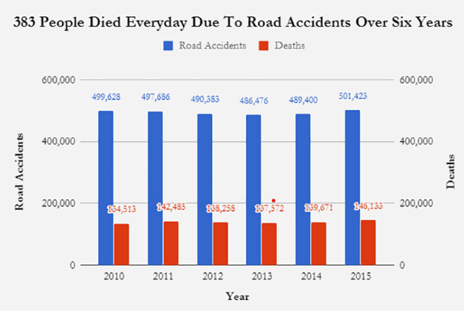
ACCIDENT RATES OVER THE YEARS

Slide 6
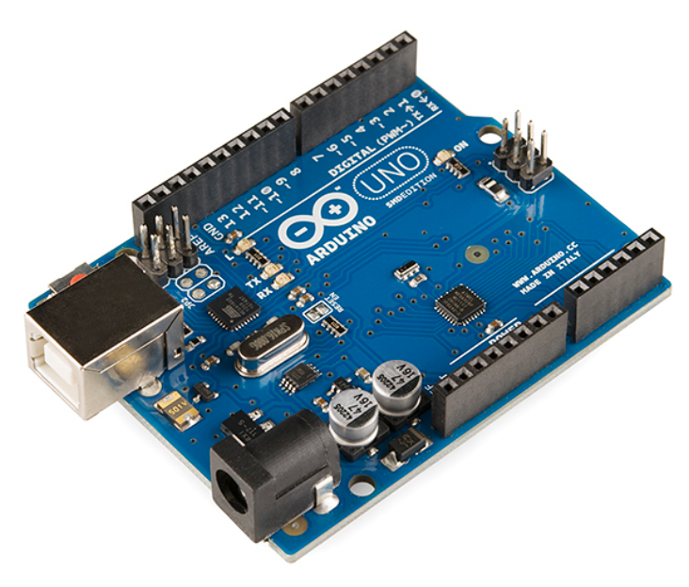
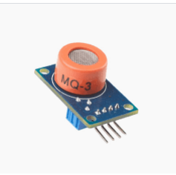
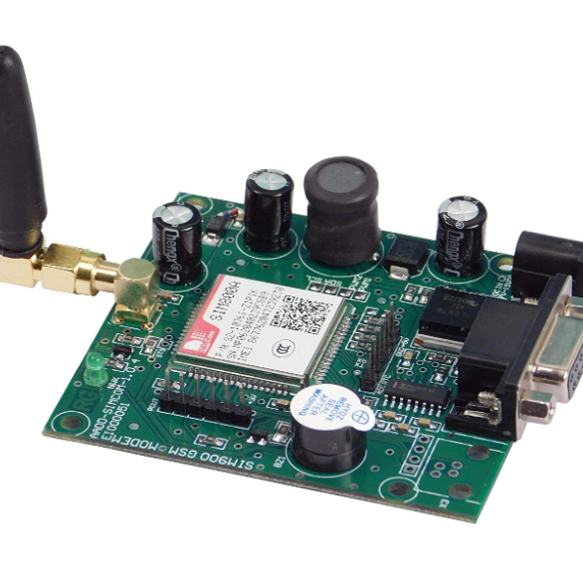
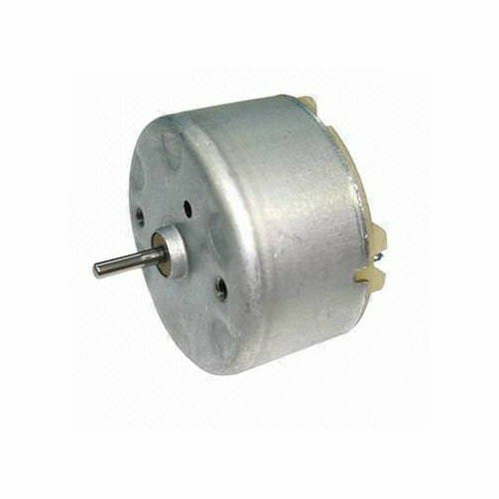
IMPORTANT COMPONENTS
ARDUINO UNO
MQ-3
GSM
DC MOTOR
MICRO-CONTROLLER
ALCOHOL DETECTION SENSOR
SMS SENDING MODULE
OUTPUT DEVICES

Slide 7
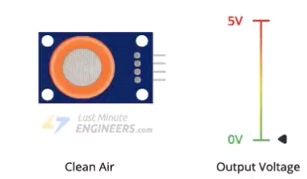
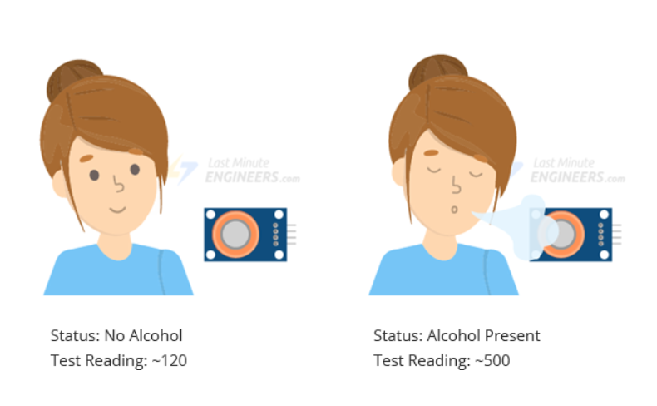

Slide 8



WORKING AND FACTORS
SENSE
action
alert
Whenever a person consumes alcohol and sits in the car the mq-3 sensor detects the alcohol presence and sends signal to arduino
When the alcohol is sensed the car’s engine doesn’t turn on , to avoid accidents related to drink and drive
To also let the family members , an sms alert is sent to the registered number if the person drinks and drives the car.

Slide 9
Conclusion
With this project we took an initiative to reduce drink and drive accident cases by taking appropriate measures in advance.
Say no to Drinking as consumption of alcohol or any addictive thing is injurious to health and is harmful for both you and your family.

Slide 10
Drinking and driving can destroy lives and families.
“
”
BE HAPPY AND KEEP YOUR FAMILY AND LOVED ONES HAPPY.

Slide 11

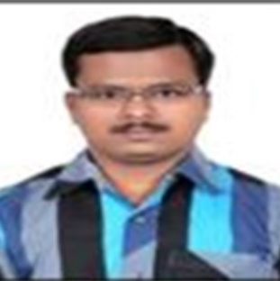

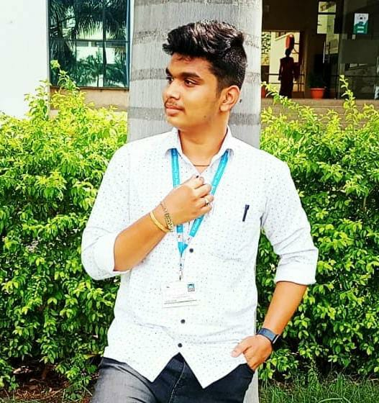
MEET OUR TEAM
P. SUMAN PRAKASH
P. VISHNU KUMAR
ADNAN ALI​
AKULA ZAHEER SHA​
HoD : AI & IoT
GUIDE and FACULTY
STUDENT
STUDENT

Slide 12
THANK YOU!
HAVE A WONDERFUL WEDNESDAY..

